Slide 1
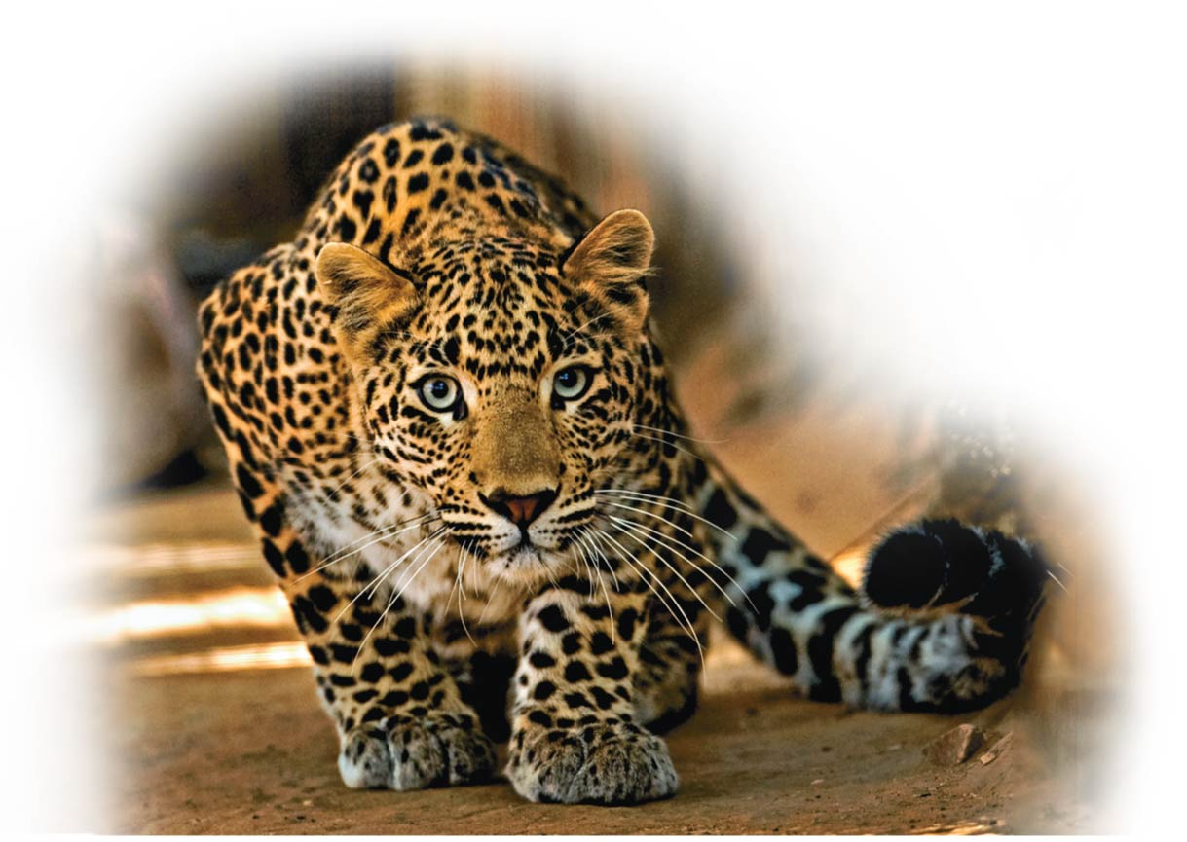
The Body’s Defenses
Immune System
Unit 5; Chapter 24

Slide 2
Learning Outcomes 1
Define the immune system and distinguish between innate and adaptive immunity.
Compare and contrast external and internal innate defenses.
Describe the inflammatory response, the role of histamine, and the effects of drugs such as ibuprofen.
Compare the circulatory and immune functions of the lymphatic system and explain how lymph is formed.

Slide 3
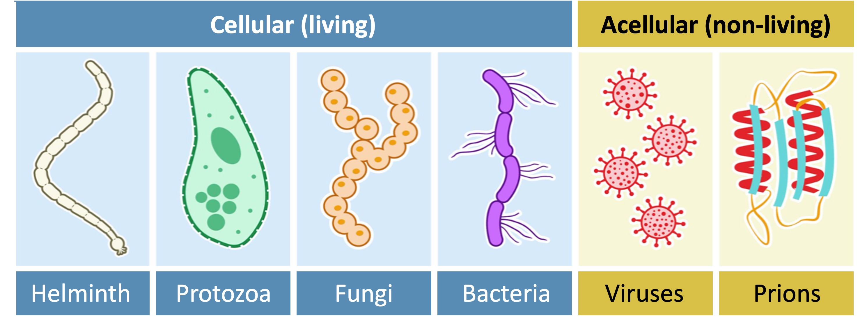
The Immune System (免疫系统) and Pathogens (病原体)
The human immune system is a collection of organs, tissues, and cells that together perform the vital function of safeguarding the body from a constant barrage of pathogens (organisms causing disease).
https://share.google/XcmbgoMcfm5MSvgxp

Slide 4
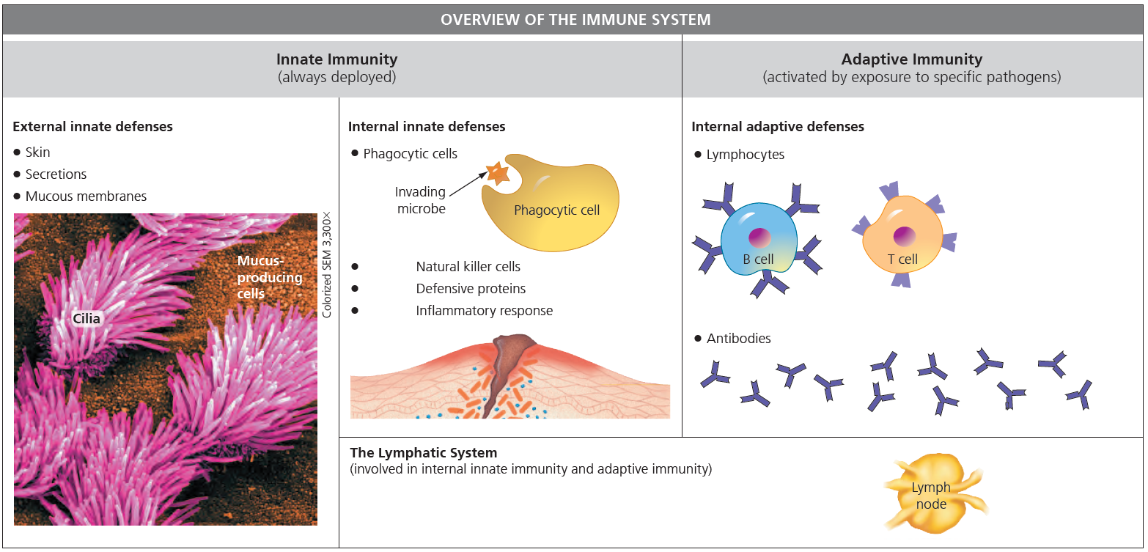

Slide 5
Innate Defenses (先天防御)
Fully ready to respond before an invader has been encountered.
  Not adaptive: do not change much
  Components attach pathogens indiscriminately (not specifically)
External barriers: external innate defenses
Internal defenses: internal innate defenses

Slide 6
Innate Defenses (先天防御): External Innate Defenses
Prevent infection
The body’s physical barriers:
  A tough outer skin layer generally impenetrable to viruses and bacteria
  Mucous membranes covered with sticky mucus
  Wax in the ear canal, which traps particles before they can get deep inside
  Secretions (分泌物) (such as tears, sweat, and saliva) with antimicrobial chemicals
  Strong stomach acids that kill most pathogens ingested with food.

Slide 7
Innate Defenses (先天防御): Internal Innate Defenses
The second line of defense
Depend on
  White blood cells, two types
    Phagocytic cells (also phagocytes) engulf foreign cells or molecules and debris from dead cells by phagocytosis, or “cellular eating”
    Natural killer (NK) cells recognize virus-infected and cancerous body cells.
  Defensive proteins
    prevent viral reproduction within body cells
    destroy pathogens directly.

Slide 8
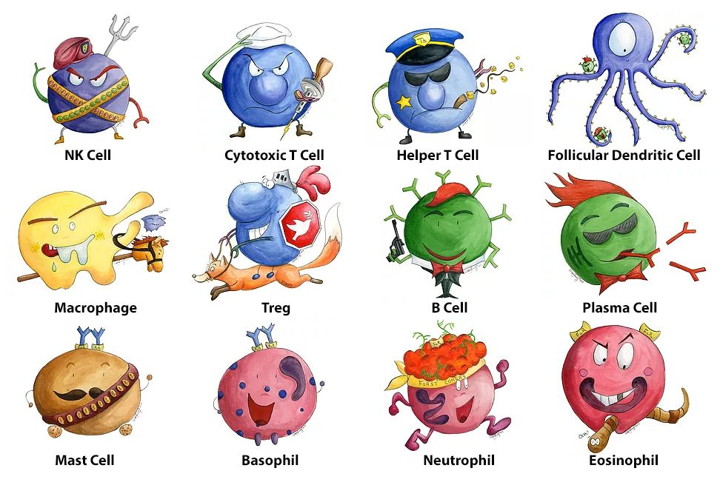
https://share.google/XMudzzQwHrouCilKd

Slide 9
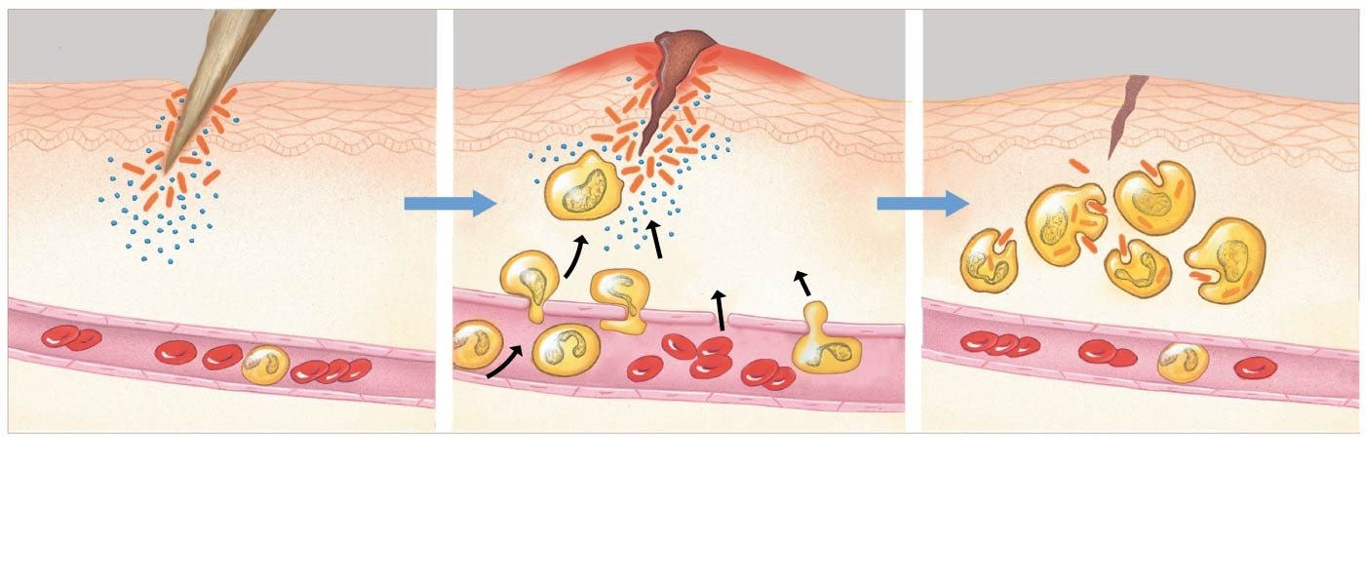
Internal Innate Defenses: The Inflammatory Response (炎症反应)
A coordinated set of nonspecific defenses in response to injury or infection. ("setting on fire")
Red, swollen, painful, and warm to the touch
Skin surface
Blood
clot
Swelling
Splinter
Bacteria
Phagocytic
cells
Phagocytic
cells and
fluid move into
area
Chemical
signals
White blood cell
Blood vessel
1
Tissue injury; release of
chemical signals such as
histamine
2
Dilation and increased
leakiness of local blood
vessels; migration of
phagocytic cells to the area
3
Phagocytic cells engulf
bacteria and cell debris;
tissue heals

Slide 10
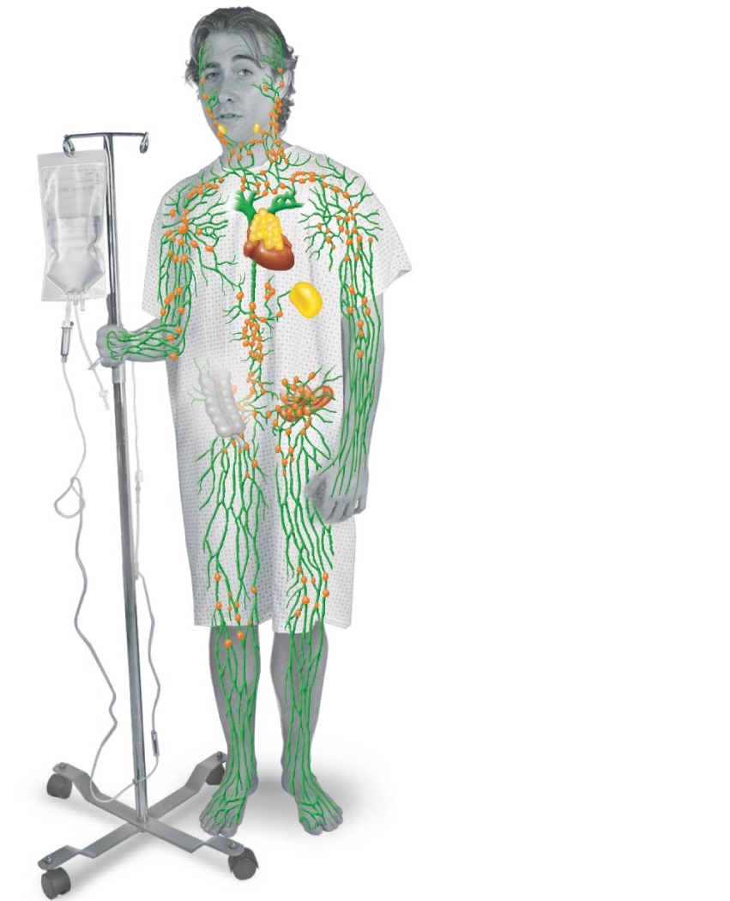
The Lymphatic System (淋巴系统)
Tonsil（扁桃体）
Consists of
  A branching network of vessels
    Carry lymph, a fluid that is similar to interstitial fluid surrounding body cells.
  Numerous lymph nodes
  Several other organs
Function:
  Returns tissue fluid to the circulatory system
  Fights infection
Lymph nodes
(淋巴结)
Lymphatic vessels
entering veins
Thymus （胸腺）
Spleen （脾脏）
Appendix
Lymphatic
vessels

Slide 11
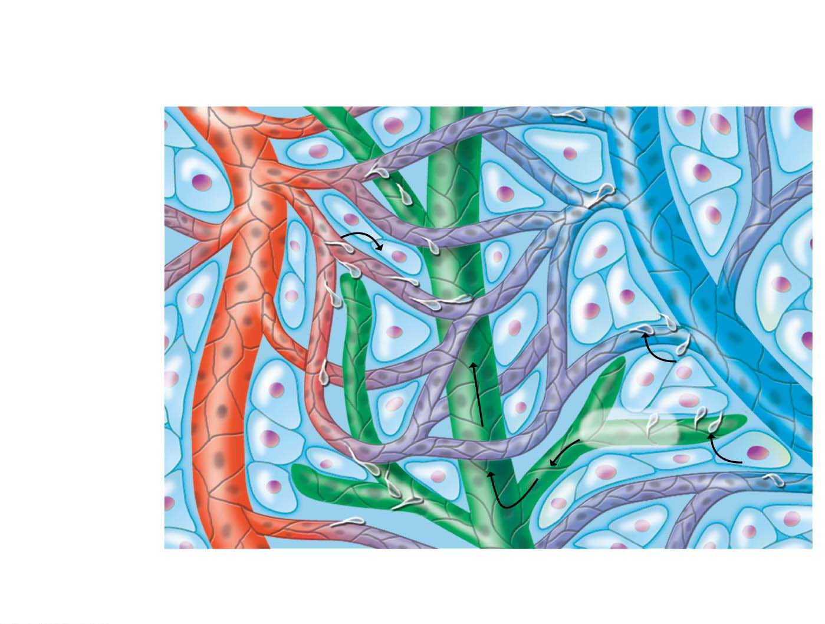
Lymphatic
vessels
Fluid re-
entering
capillaries
Arteriole
（小动脉）
Capillaries
（毛细血管）
Venule
（小静脉）
Fluid
exiting
capillaries
Lymph
Lymphatic vessels
Fluid entering
lymphatic vessel

Slide 12
Learning Outcomes 2
Explain how the immune system recognizes foreign substances with antigens.
Describe the process of clonal selection, and explain how effector cells and antibodies are produced and what their functions are.
Compare and contrast the roles of cytotoxic T cells, helper T cells, and B cells in the immune response.
Explain how the immune system has “memory.”
Explain how vaccinations can prevent disease.

Slide 13
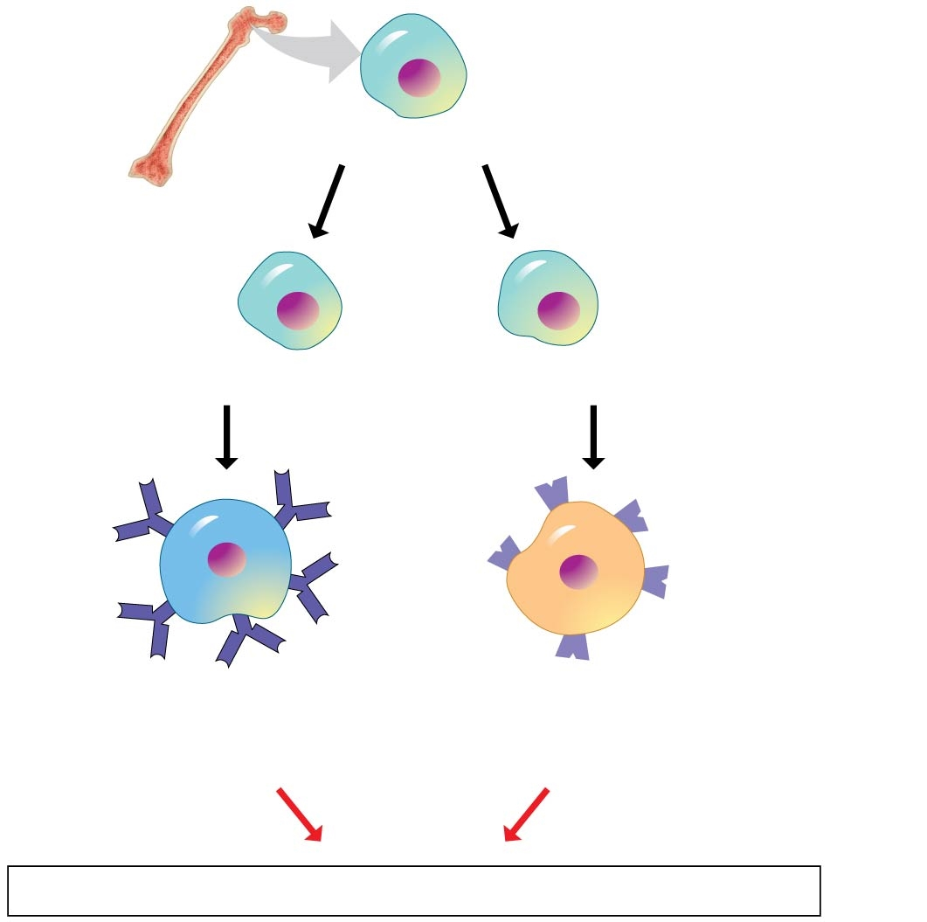
Adaptive Defenses
Bone marrow
Stem cell in bone marrow
The third line of defense
Activated after exposure to specific pathogens
By lymphocytes
  Two types: B cells and T cells
  Recognize and respond to specific invading pathogens
Immature lymphocytes in bone marrow
Via blood to thymus
B cell
(matures in
bone marrow)
T cell
(matures in
thymus)
Via blood
Lymph nodes, spleen, and other lymphatic organs

Slide 14
Adaptive Defenses Step 1: Recognizing the Invaders
Antigens (抗原), molecules can elicit a response from a lymphocyte
  on the surfaces of viruses or foreign cells (bacteria or parasitic worms)
  toxins by from bacteria
  molecules from mold spores, pollen, and house dust
  molecules on cell surfaces of transplanted tissue
B cells and T cells have antigen receptors on their surface that can bind to an antigen. (lock-and-key fit)
  Each cell has about 100,000 copies of an antigen receptor that detects only a single type of antigen. (specificity)
The immune system has a very large number of B cells and T cells — so much so that they can bind to almost every possible antigen.

Slide 15
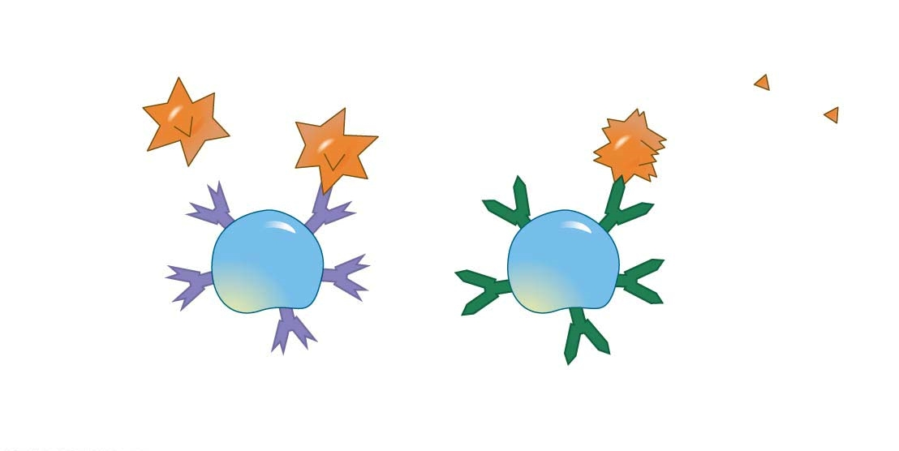
Adaptive Defenses Step 1: Recognizing the Invaders by B Cells
Antigen receptors on B cells specialize in recognizing intact antigens that are on the surface of pathogens or circulating freely in body fluids.
Pathogen
B cell antigen receptor
binds to a specific antigen.
Freely
circulating
antigens
(such as
toxins)
Antigens
on the
surface
B cell
B cell
Antigen receptors

Slide 16
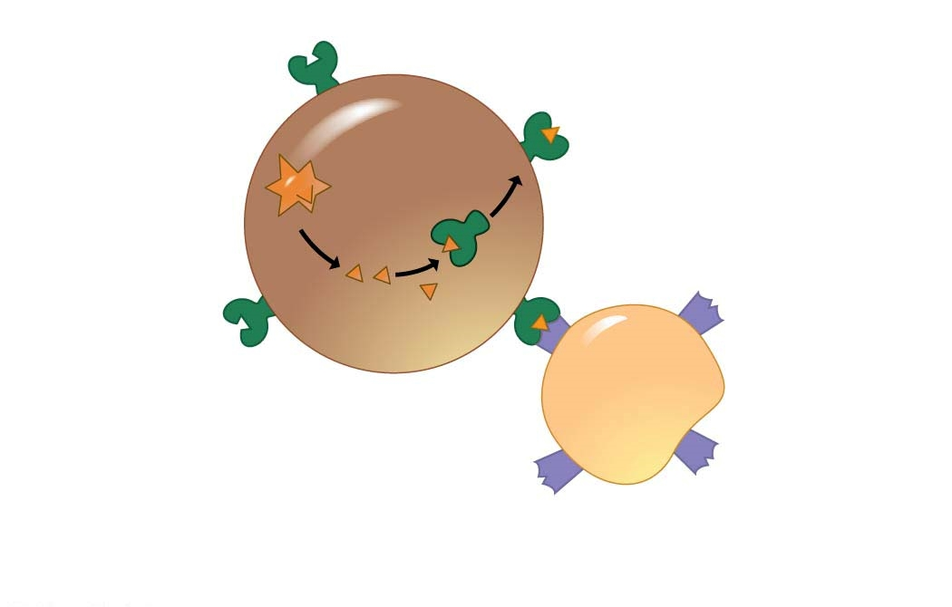
Adaptive Defenses Step 1: Recognizing the Invaders by T Cells
Antigen receptors on T cells only recognize fragments of antigens, and the fragments must be presented on the surface of body cells by special proteins before T cells can be activated.
Self
protein
Self protein
displaying a
foreign antigen
fragment
Pathogen
Body cell
Three-part interaction
T cell
T cell antigen receptor
binds to the self protein
and a specific antigen
fragment.
Antigen
receptors

Slide 17
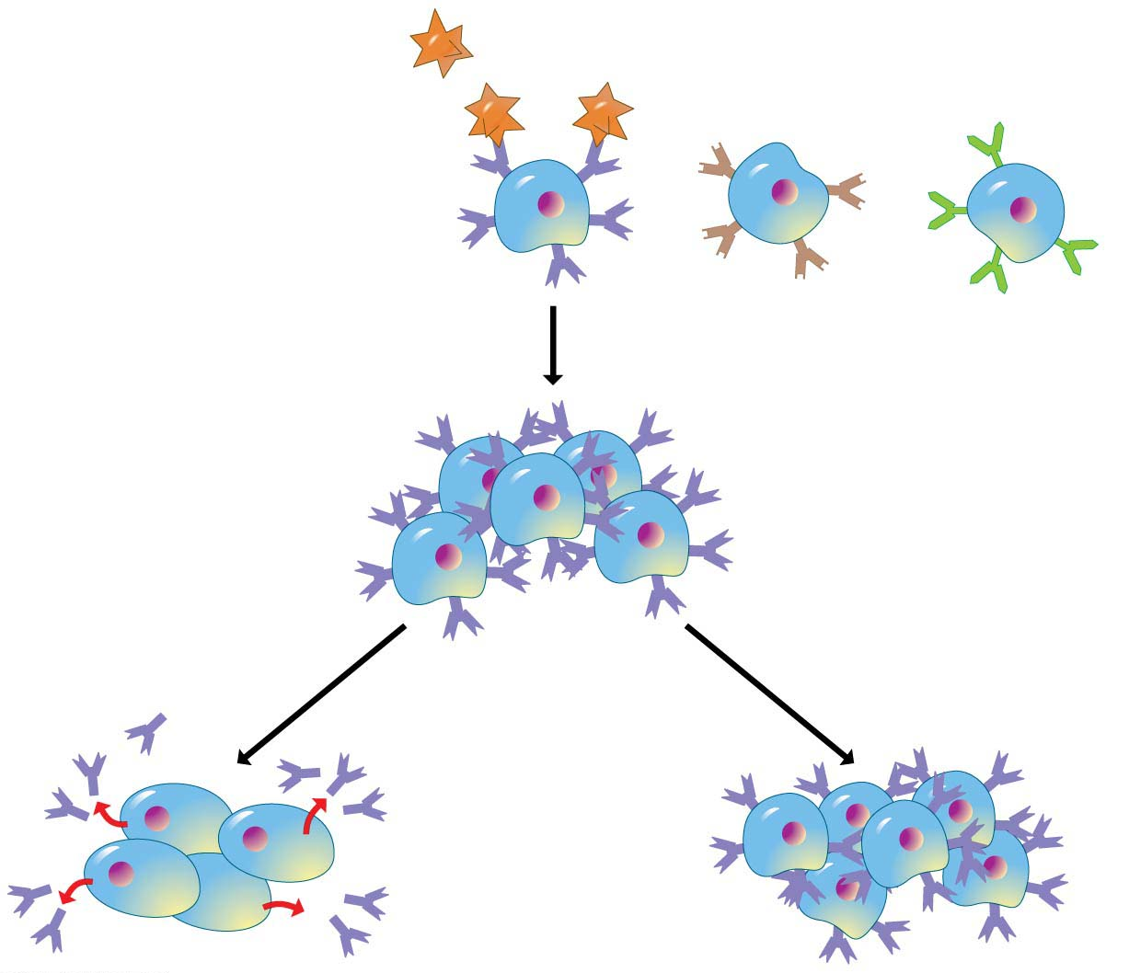
Adaptive Defenses Step 2: Clonal Selection
Antigens on the
surface of a
pathogen
1
B cells that
recognize
different
antigens
Antigen receptor
on cell surface
2
A clone of identical cells
with the same antigen receptors
Clone of effector
B cells, short-lived
3
4
Clone of memory
B cells, long-lived
Antibodies

Slide 18
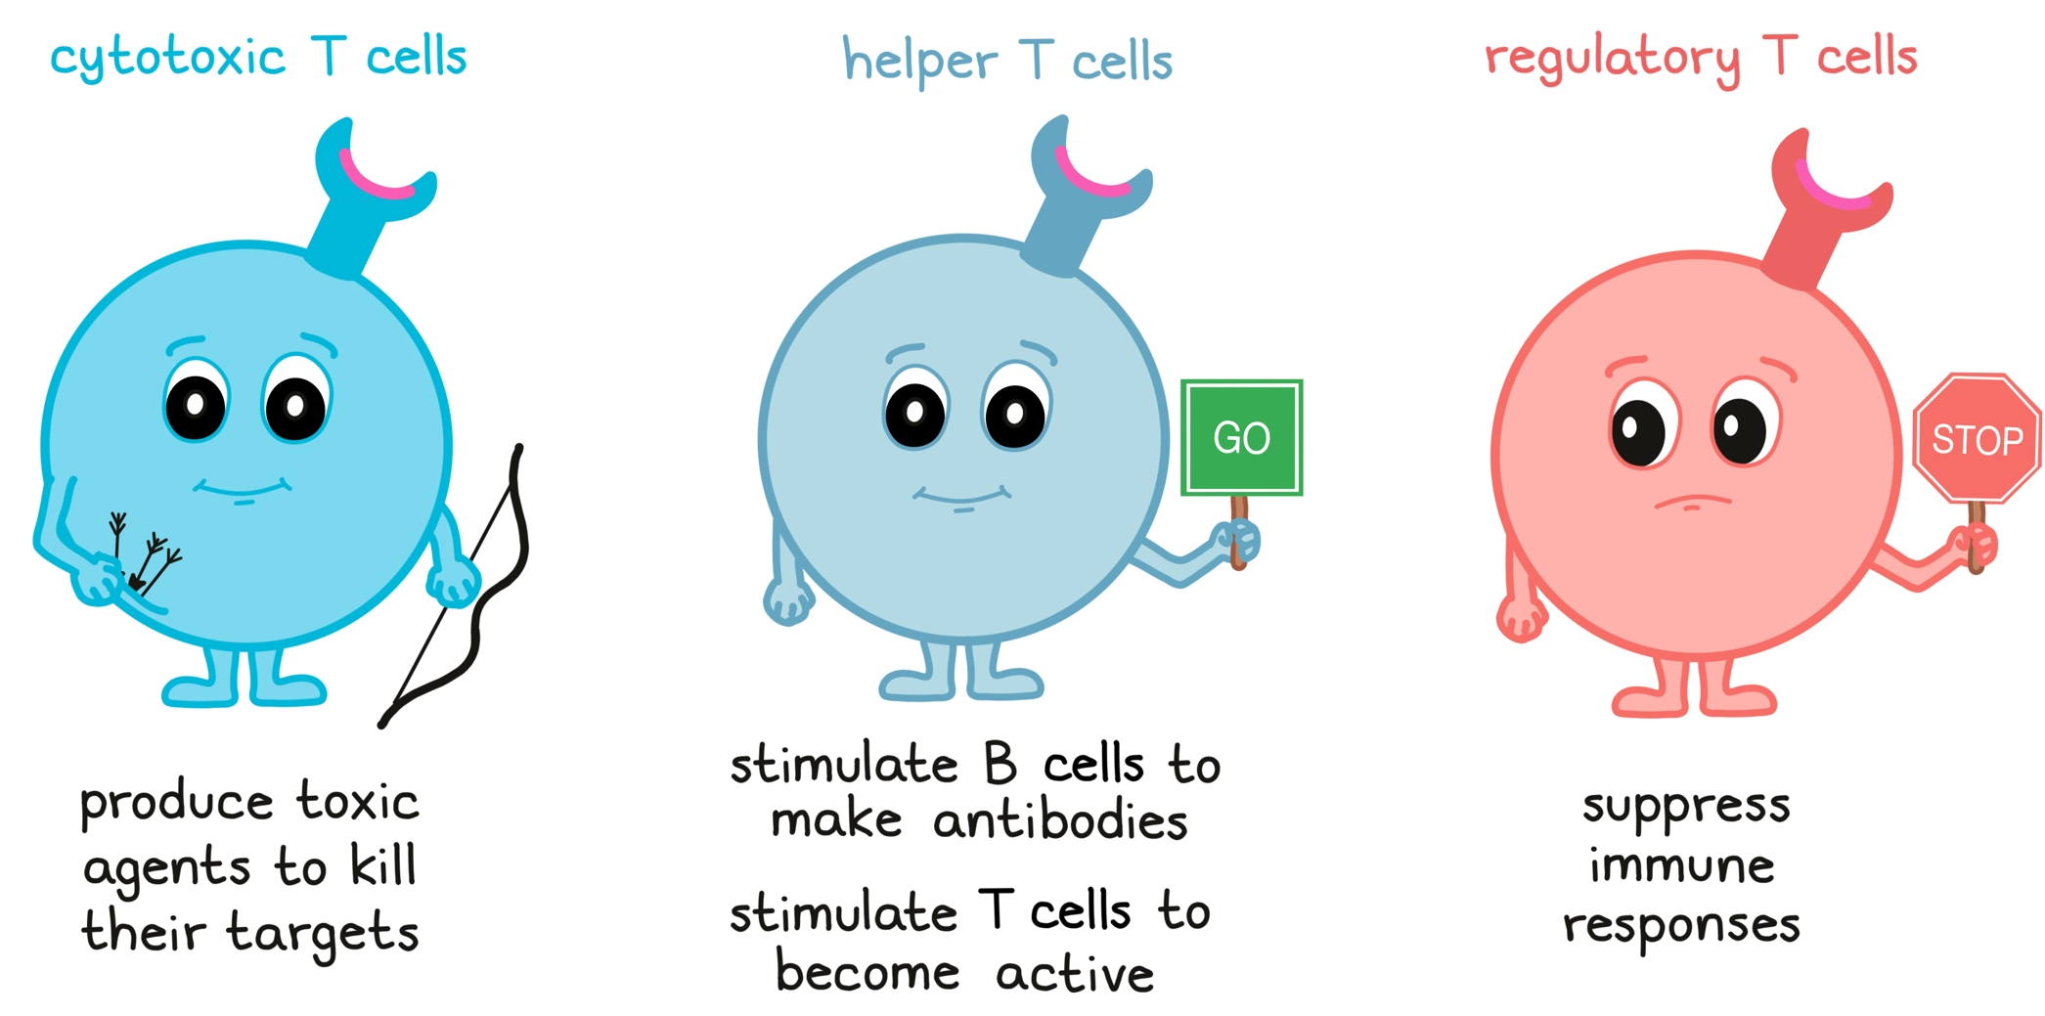
Adaptive Defenses Step 3: Responding to Invaders
The Helper T Cell Response
The B Cell Response
The Cytotoxic T Cell Response
https://share.google/XfllSDDCfQshyLkIi

Slide 19
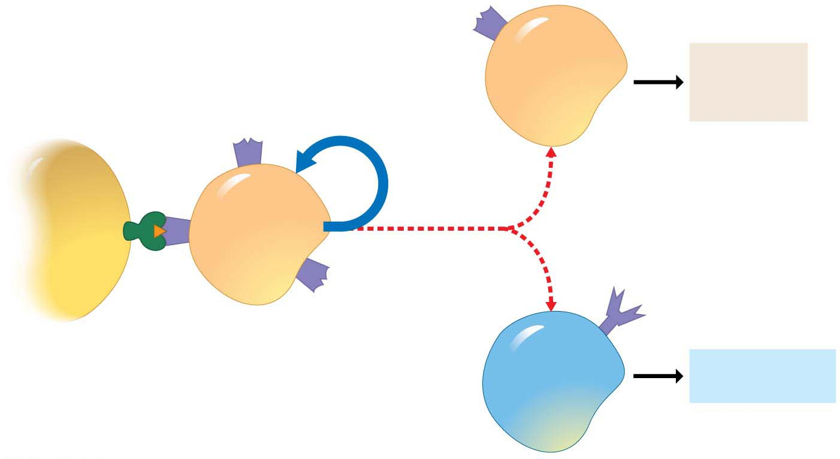
Adaptive Defenses Step 3:
Responding to Invaders by Helper T Cells
Cytotoxic
T cell
Attack on
infected
cells
T cell
receptor
Clonal
selection
Activates
other T cells
and B cells
Phagocytic
cell
Activated
helper
T cell
Secretes various cytokines
Antigen fragment
displayed on self
Protein
B cell
Secretion of
antibodies

Slide 20
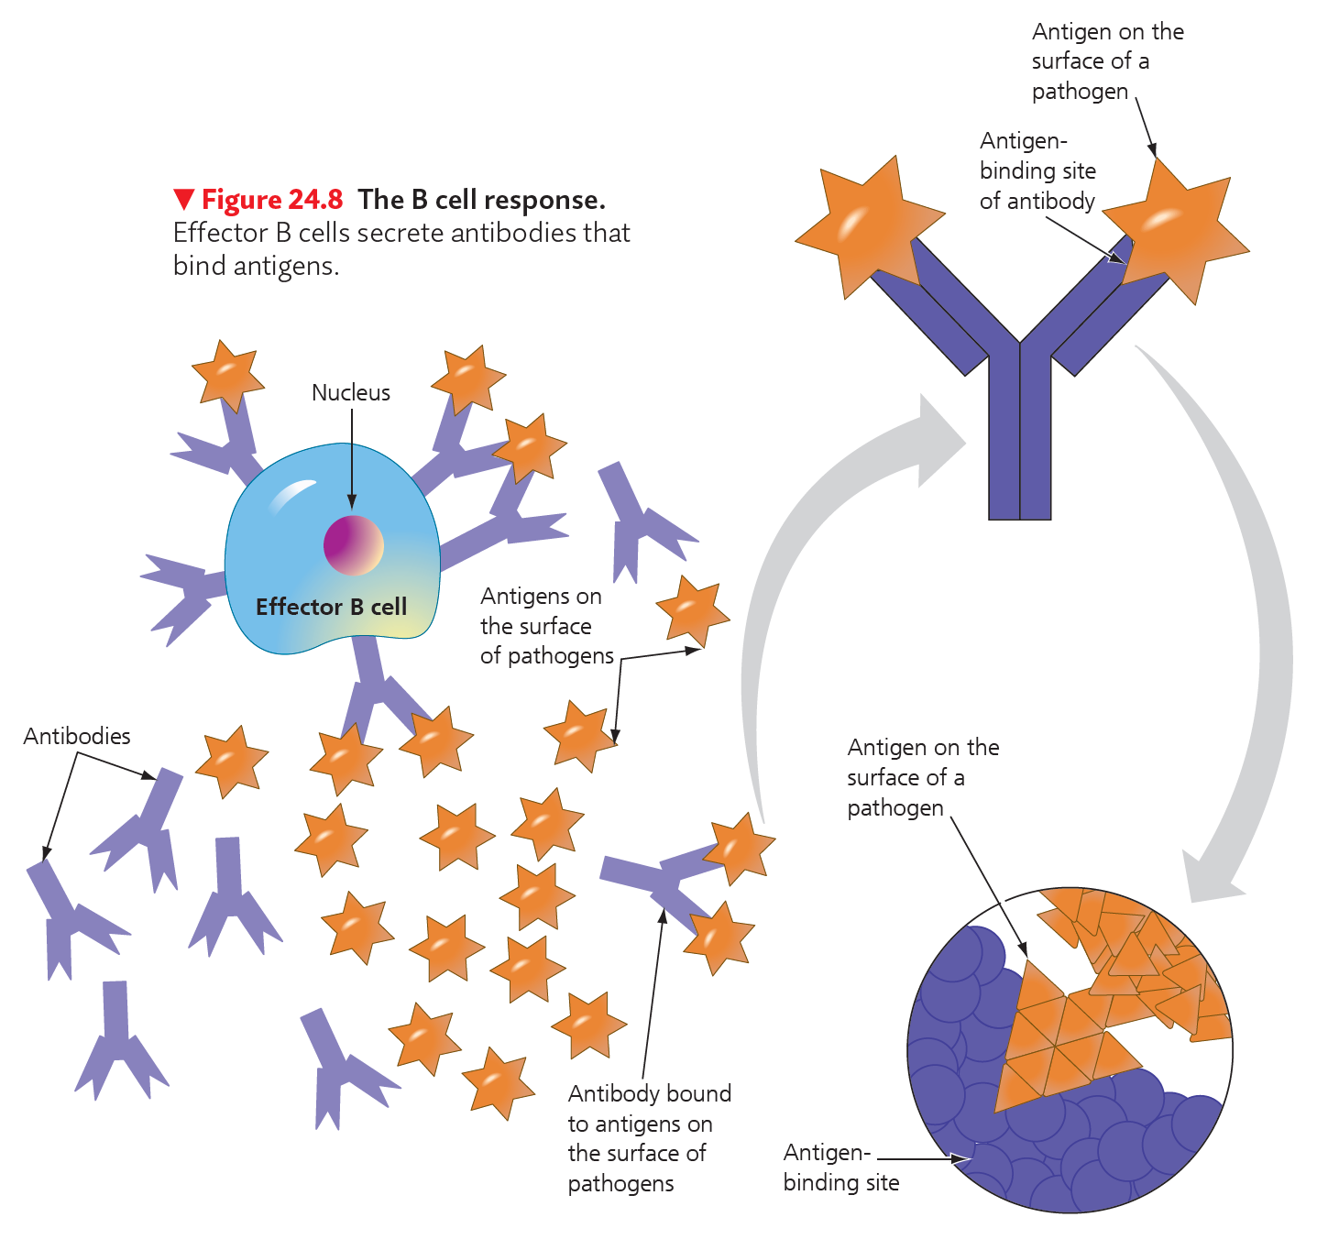
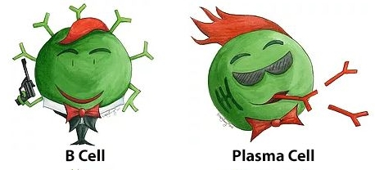
Adaptive Defenses Step 3:
Responding to Invaders by B Cells/Humoral Immune Response
Secretion antibodies into the blood and lymph
  up to 2,000 antibodies per second
B cells defend primarily against pathogens circulating in body fluids

Slide 21
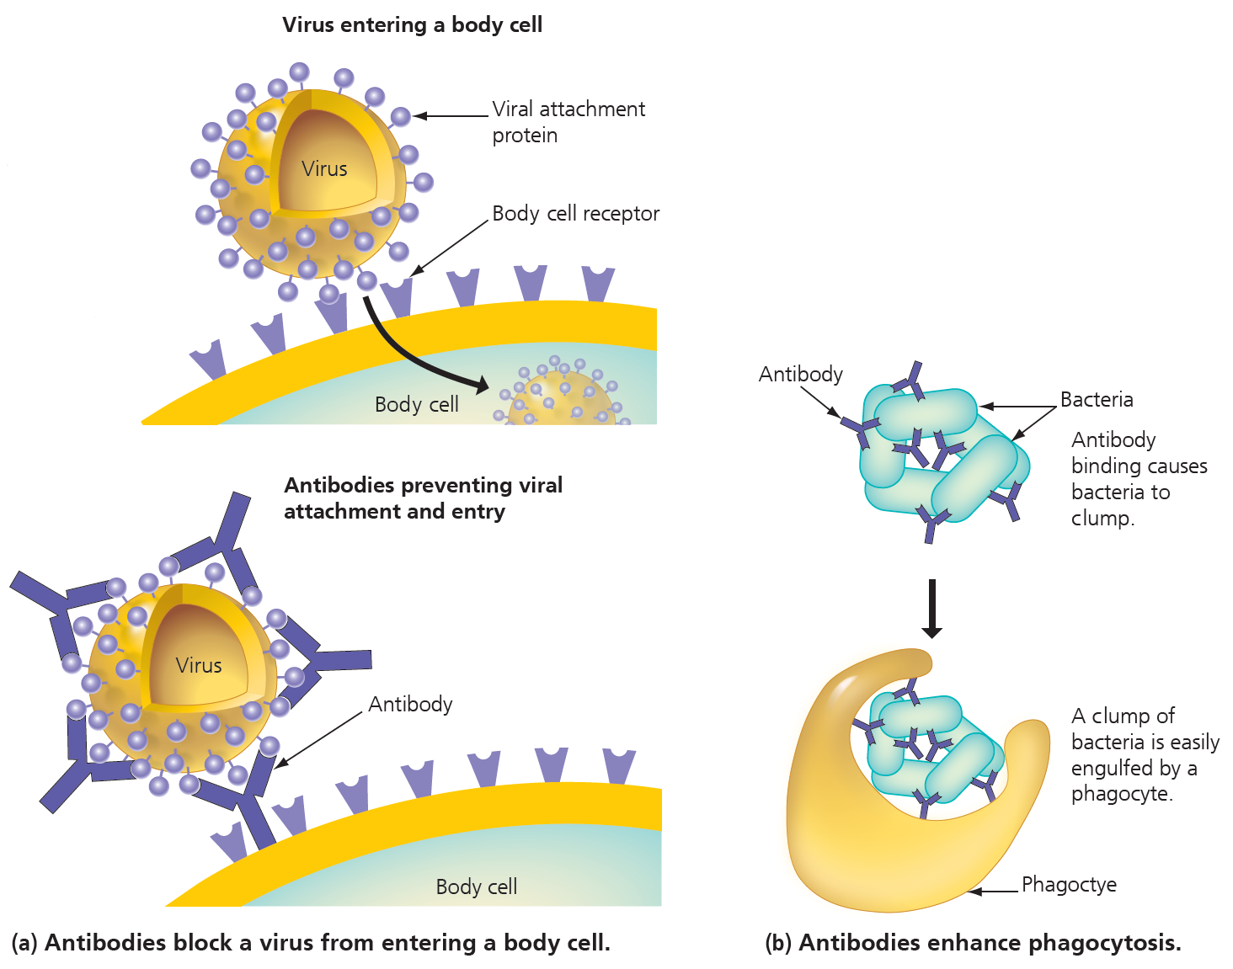
Antibody Functions to Blocks or Helps to Destroy An Invader

Slide 22
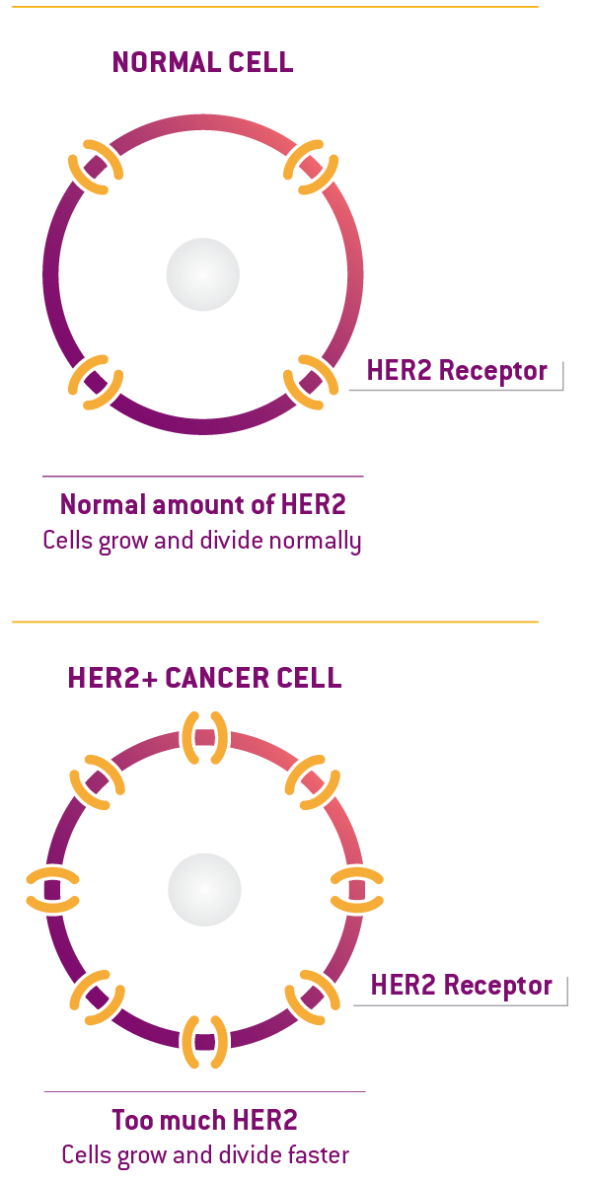
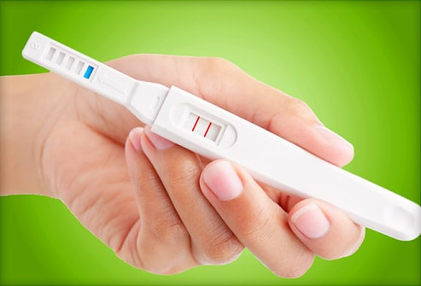
Medical and Research Application of Antibody
Herceptin, a genetically engineered antibody, treats certain cases of aggressive breast cancer.
  When Herceptin binds to a receptor present on some breast cancer cells, it interferes with the ability of those cells to receive cell growth signals. With growth receptors blocked, cancer cells cannot grow and divide.
In home pregnancy tests, antibodies are used to detect a hormone called human chorionic gonadotropin (HCG), present in the urine of pregnant women.

Slide 23
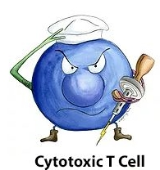
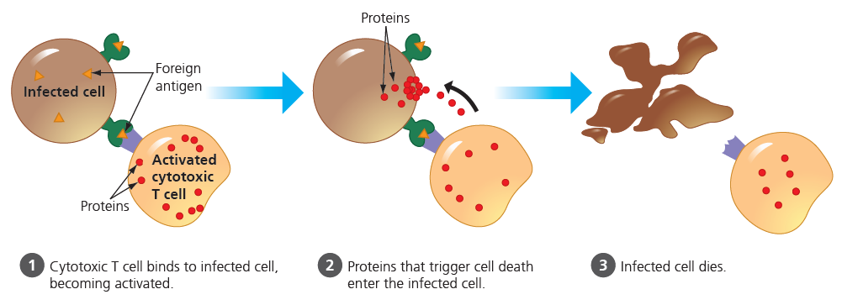
Adaptive Defenses Step 3: Responding to Invaders by Cytotoxic T Cells
The cytotoxic T cell response defends against pathogens that have entered body cells.
  Cytotoxic T cells are the only T cells that actually kill infected cells.
  Organ rejection

Slide 24
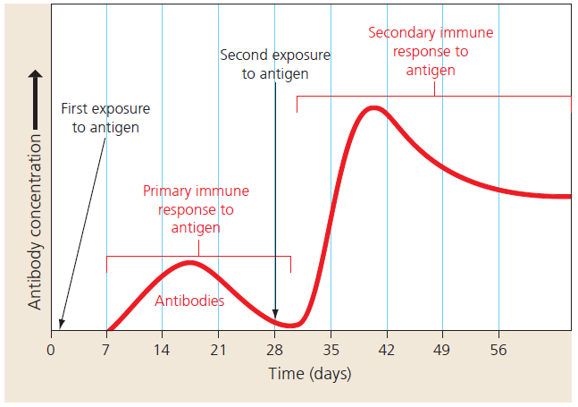
Adaptive Defenses Step 4: Remembering Invaders
Memory cells can last decades in the lymph nodes
Primary immune response, during the first response to an antigen.
Secondary immune response, when a “known” antigen is encountered again
  mediated by memory cells
    rapidly give rise to new effector cells and memory cells
  more rapid
  of greater magnitude
  of longer duration

Slide 25
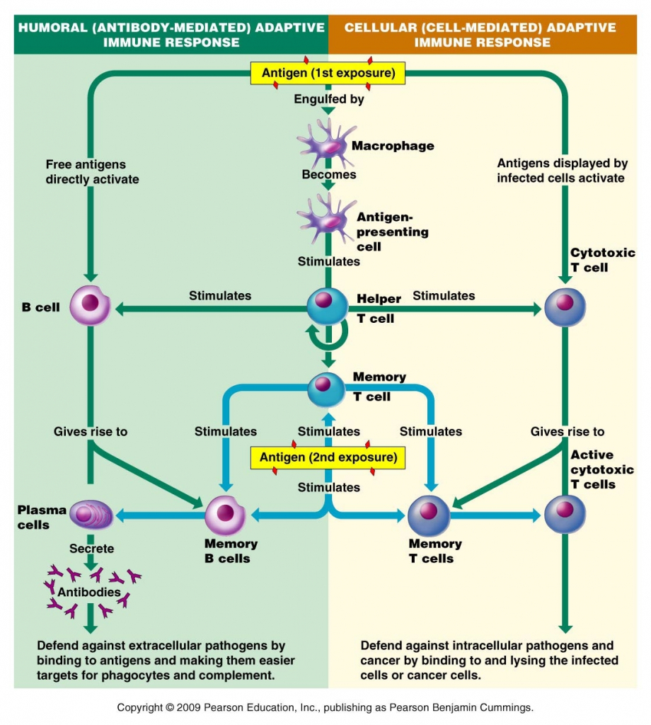

Slide 26
Vaccine (疫苗)
Edward Jenner (1796) developed a smallpox (天花) vaccine using milder cowpox viruses.
  Smallpox has been eradicated around the world in 1980.
Immunity can be achieved artificially by vaccination (immunization).
  Vaccination confronts the immune system with a vaccine, which includes a harmless version of a disease-causing microbe or one of its parts.
  Vaccination induces the primary immune response that produces memory cells.
  The protection may last for life.

Slide 27
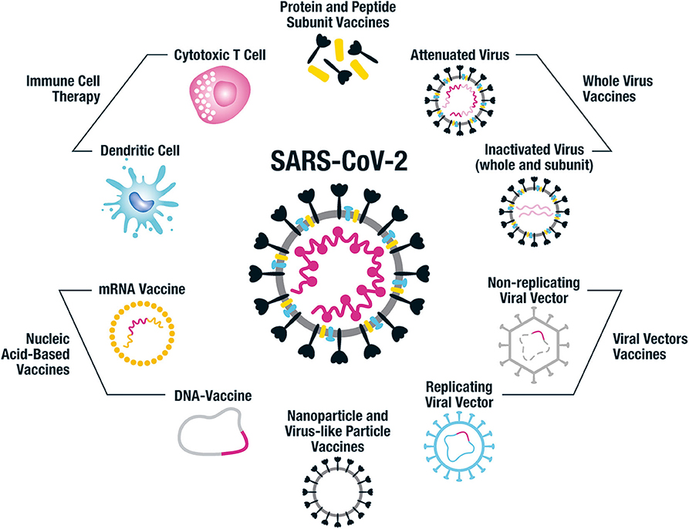
Flanagan KL, Best E, Crawford NW, Giles M, Koirala A, Macartney K, Russell F, Teh BW and Wen SCH (2020) Progress and Pitfalls in the Quest for Effective SARS-CoV-2 (COVID-19) Vaccines. Front. Immunol. 11:579250. doi: 10.3389/fimmu.2020.579250

Slide 28
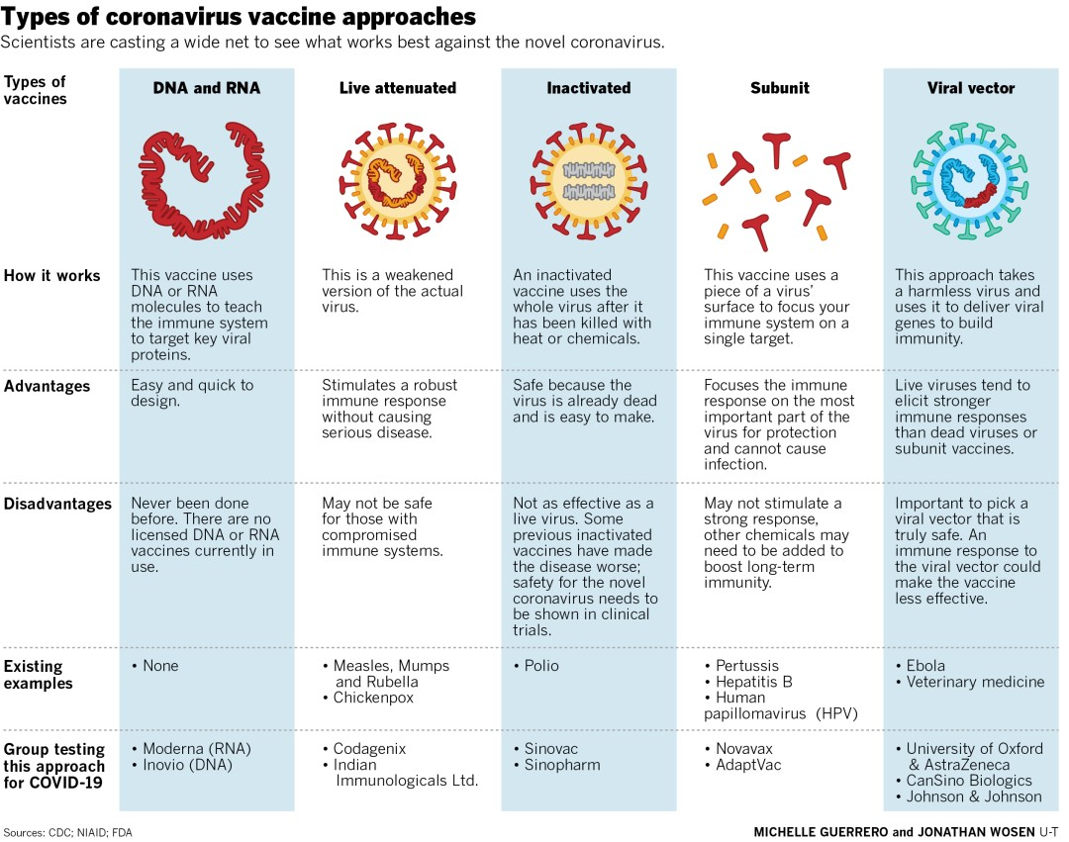
Pathak, D., Philo Magdalene, A. (2022). COVID-19 Vaccine Development and Administration in India. In: Pachauri, S., Pachauri, A. (eds) Health Dimensions of COVID-19 in India and Beyond. Springer, Singapore. https://doi.org/10.1007/978-981-16-7385-6_7

Slide 29
Learning Outcomes 3
Define an allergen, an allergy, and describe the two steps of an allergic reaction.
Compare and contrast autoimmune diseases and immunodeficiency diseases.
Explain how immune checkpoint therapy and other immunotherapies work.

Slide 30
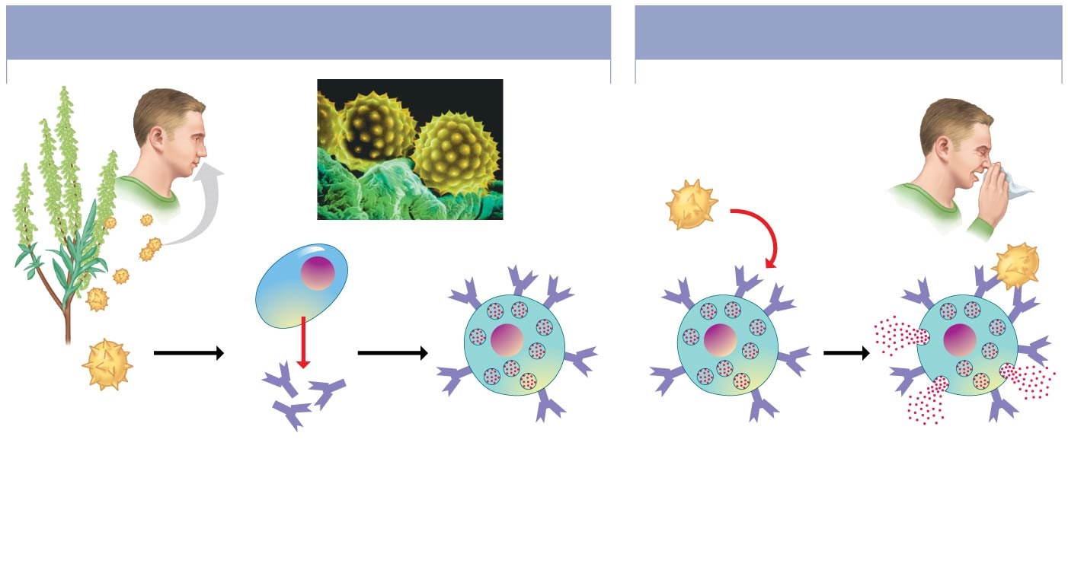
Immune Disorders: Allergies (过敏)
Exaggerated sensitivities to harmless antigens in the environment.
Allergens (过敏原) are antigens that cause allergies.
SENSITIZATION:
INITIAL EXPOSURE TO ALLERGEN
LATER EXPOSURES
TO SAME ALLERGEN
Ragweed
pollen
grains
Colorized SEM
Histamine
Effector
B cell
Mast
cell
1
Allergen
(pollen grain)
enters
bloodstream.
2
B cells make
antibodies.
IgE
3
Antibodies
attach to
mast cells.
(肥大细胞)
4
Allergen binds
to antibodies
on mast cells.
5
Histamine is released,
causing allergy
symptoms.

Slide 31
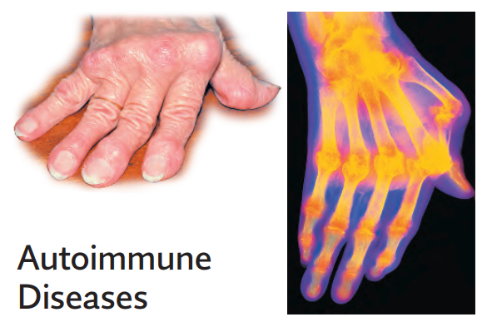
Immune Disorders: Autoimmune Diseases
Caused by that the immune system improperly turns against the body’s own molecules
  Systemic lupus erythematosus (系统性红斑狼疮)
    target self-molecules proteins, DNA
  Rheumatoid arthritis (类风湿性关节炎)
    target cartilage and bones of joints
  Insulin-dependent diabetes (一型糖尿病)
    target insulin-producing cells
  Multiple sclerosis (多发性硬化症)
    target proteins in neurons

Slide 32
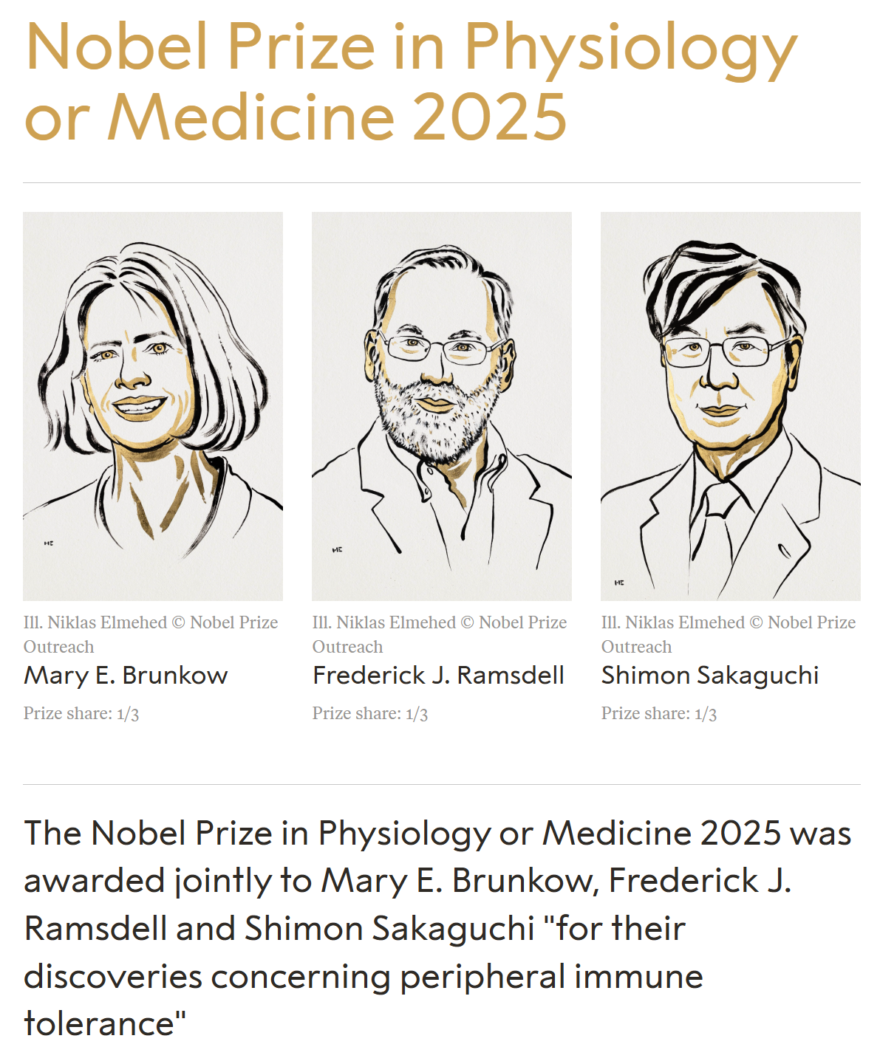
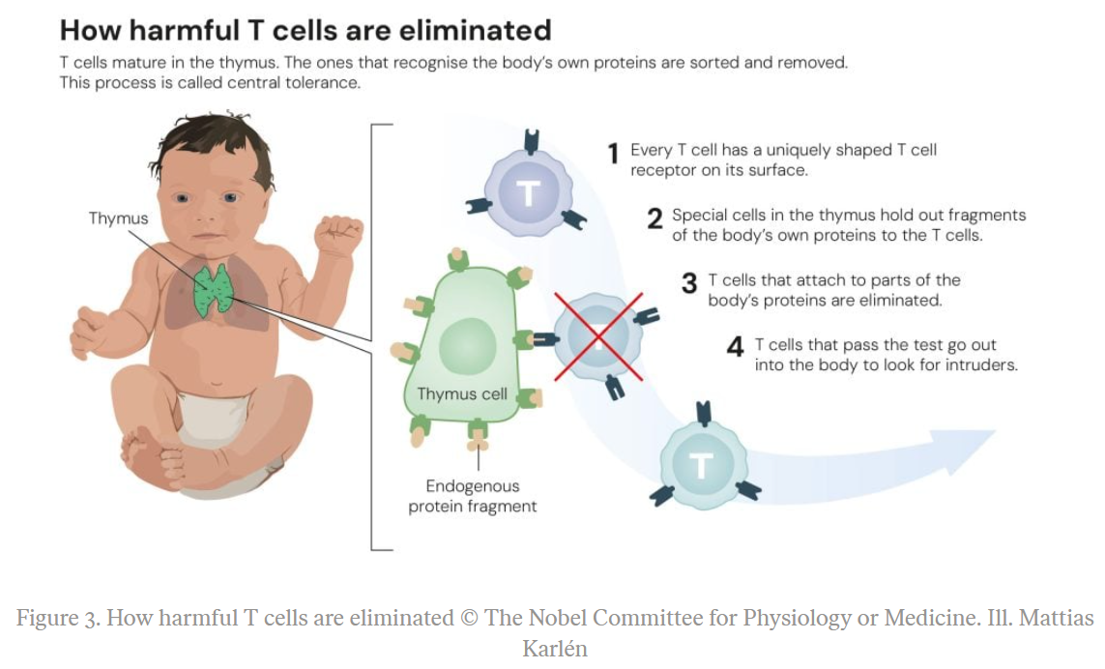
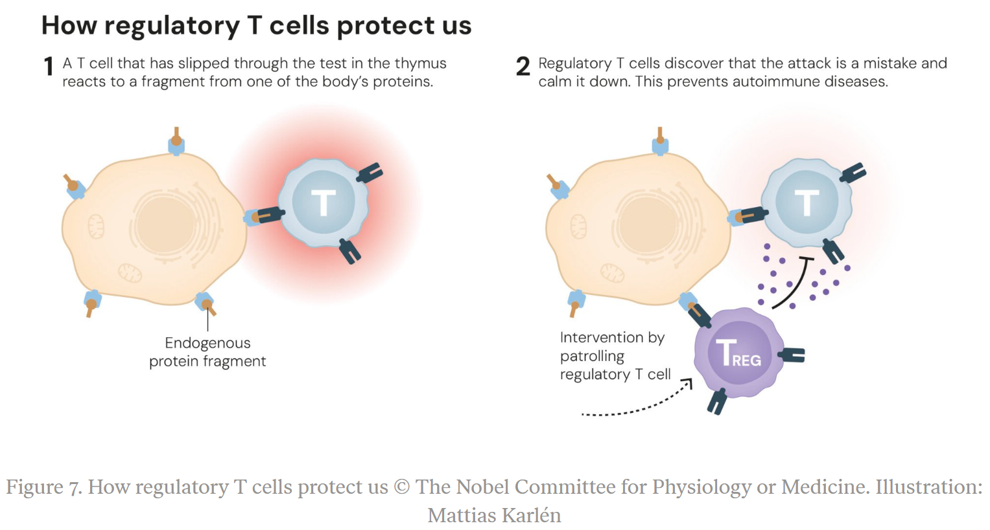
Popular information. NobelPrize.org. Nobel Prize Outreach 2025. Sat. 6 Dec 2025. <https://www.nobelprize.org/prizes/medicine/2025/popular-information/>

Slide 33
Immune Disorders: Immunodeficiency Diseases
When one or more of the components of the immune system are lacking, affected people become more susceptible to infections.
Immunodeficiency may arise from
  inborn conditions such as severe combined immunodeficiency (SCID)
    both B cells and T cells are absent or inactive
  radiation or drug therapies used against many cancers
  acquired illness, such as AIDS
    By HIV attacking helper T cells severely impairs the adaptive immune defenses
    Prevention by education: safe sex behaviors, such as abstinence and using condoms

Slide 34
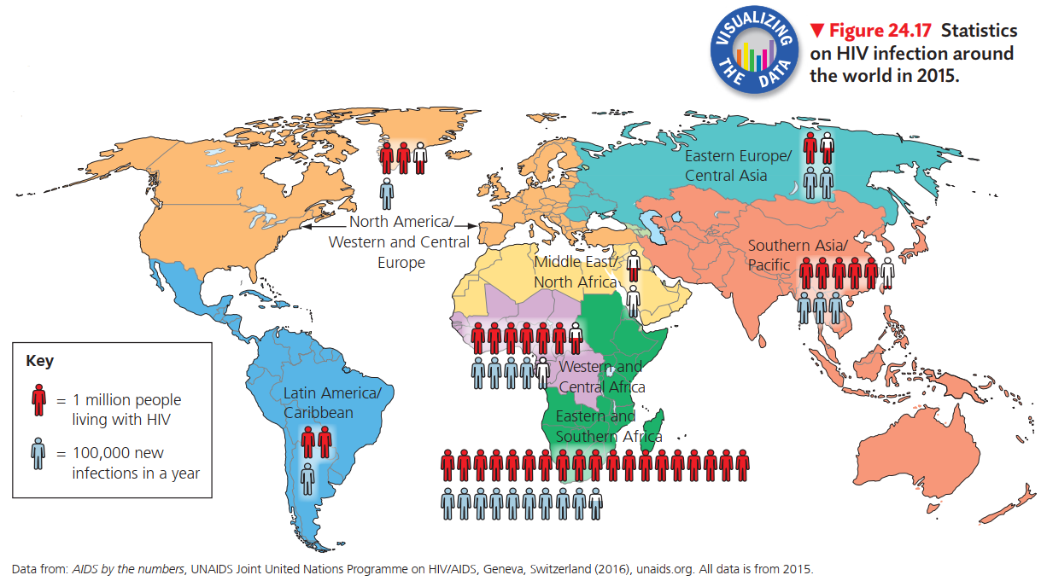
https://www.ted.com/talks/philip_a_chan_how_close_are_we_to_eradicating_hiv?language=en#t-70307

Slide 35
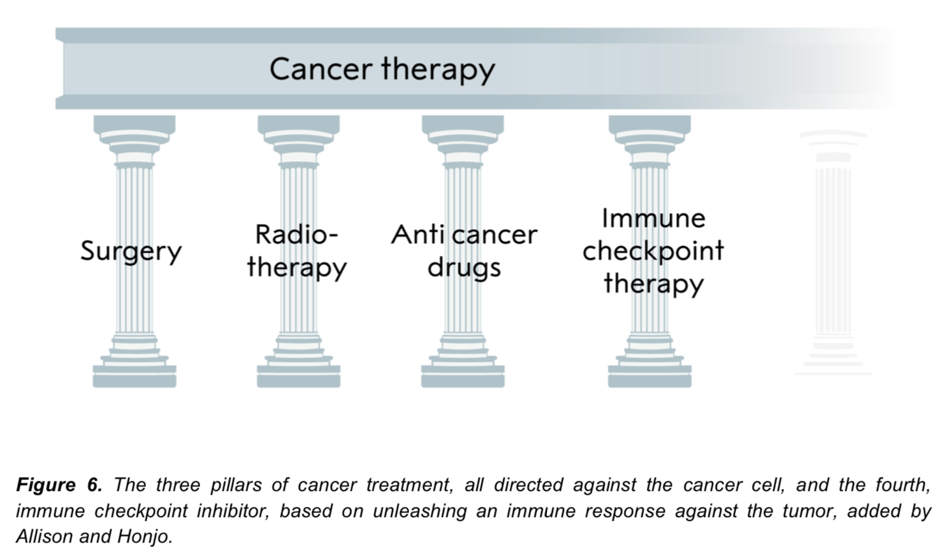
Cancer Immunotherapy
Chemotherapy

Slide 36
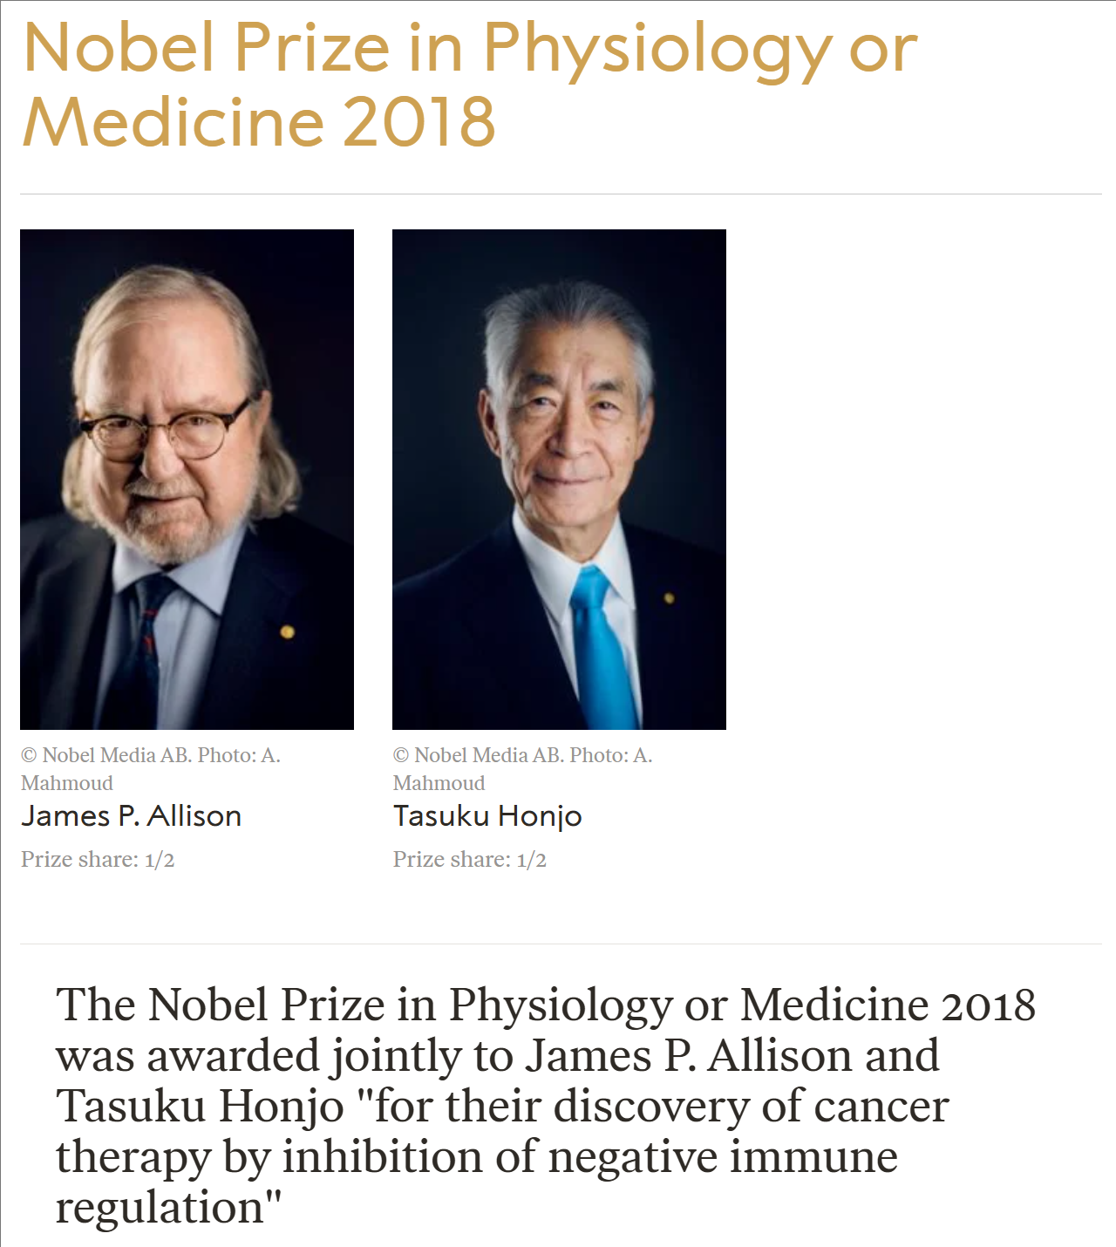
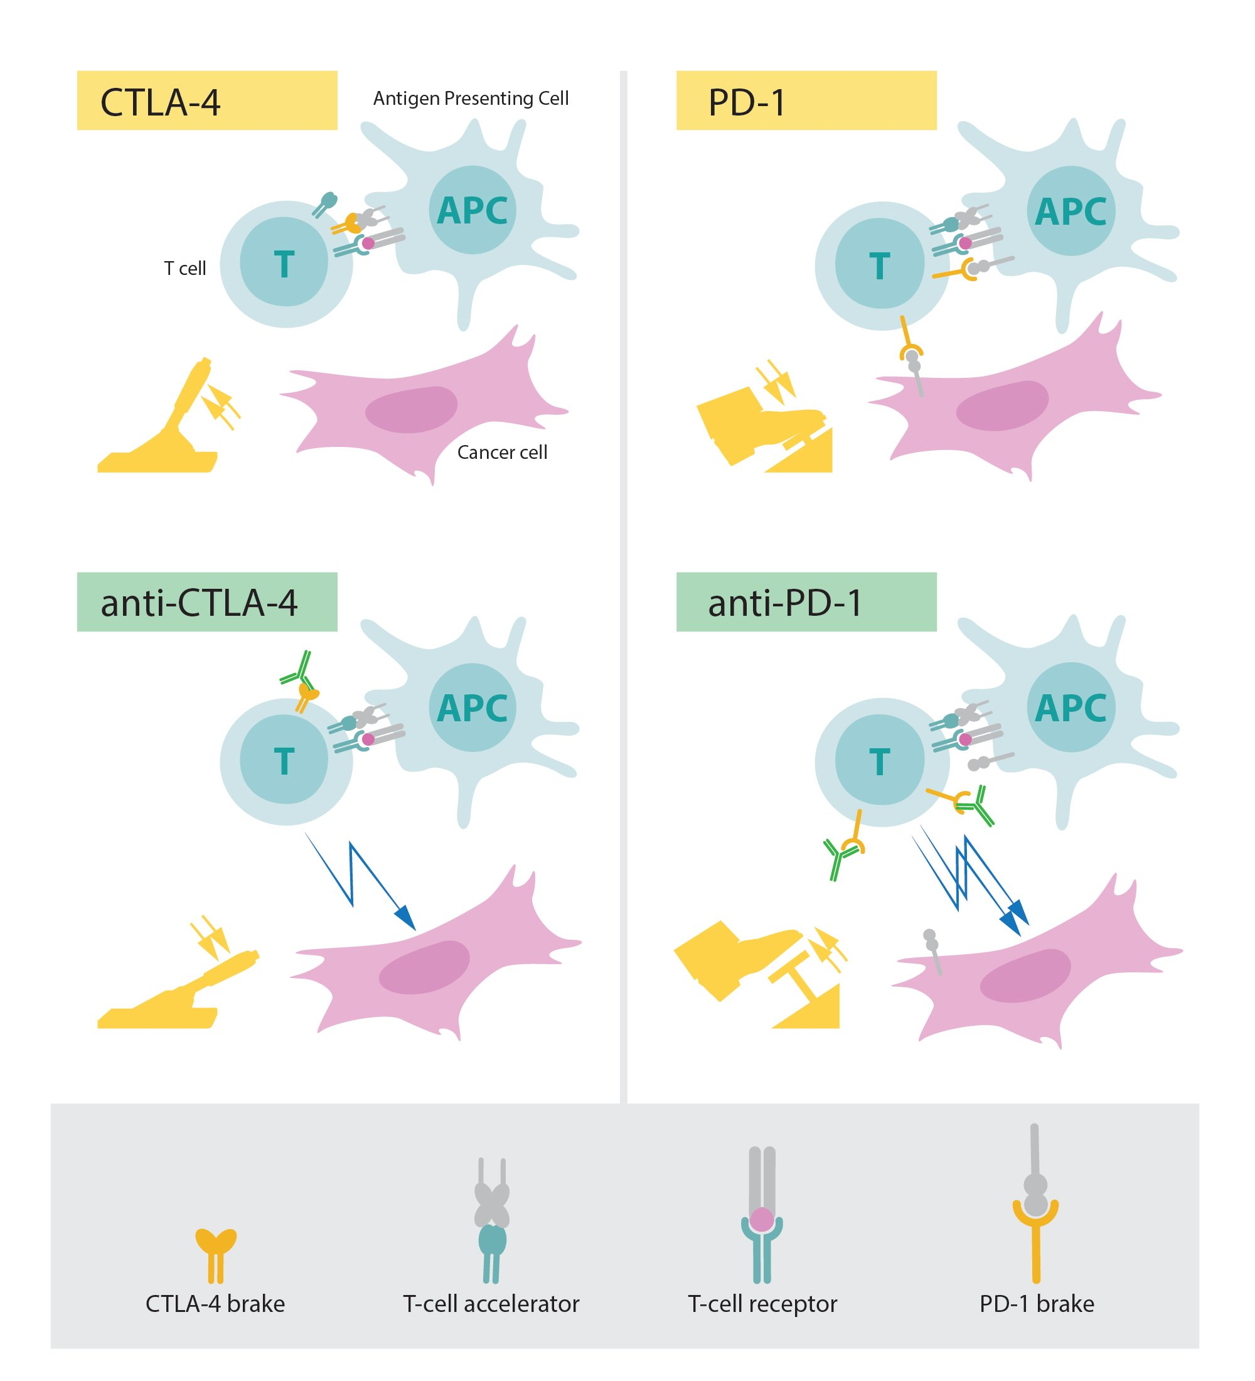
Press release. NobelPrize.org. Nobel Prize Outreach 2025. Sun. 20 Jul 2025. <https://www.nobelprize.org/prizes/medicine/2018/press-release/>

Slide 37

James Allison & CTLA-4
The "Brake" Breakthrough
CTLA-4 (Cytotoxic T-lymphocyte-associated protein 4)
A “parking brake” on T cells
Removing the brake lets T-cells attack tumors
CTLA-4 Off = Immune Attack On!
Press release. NobelPrize.org. Nobel Prize Outreach 2025. Sun. 20 Jul 2025. <https://www.nobelprize.org/prizes/medicine/2018/press-release/>

Slide 38
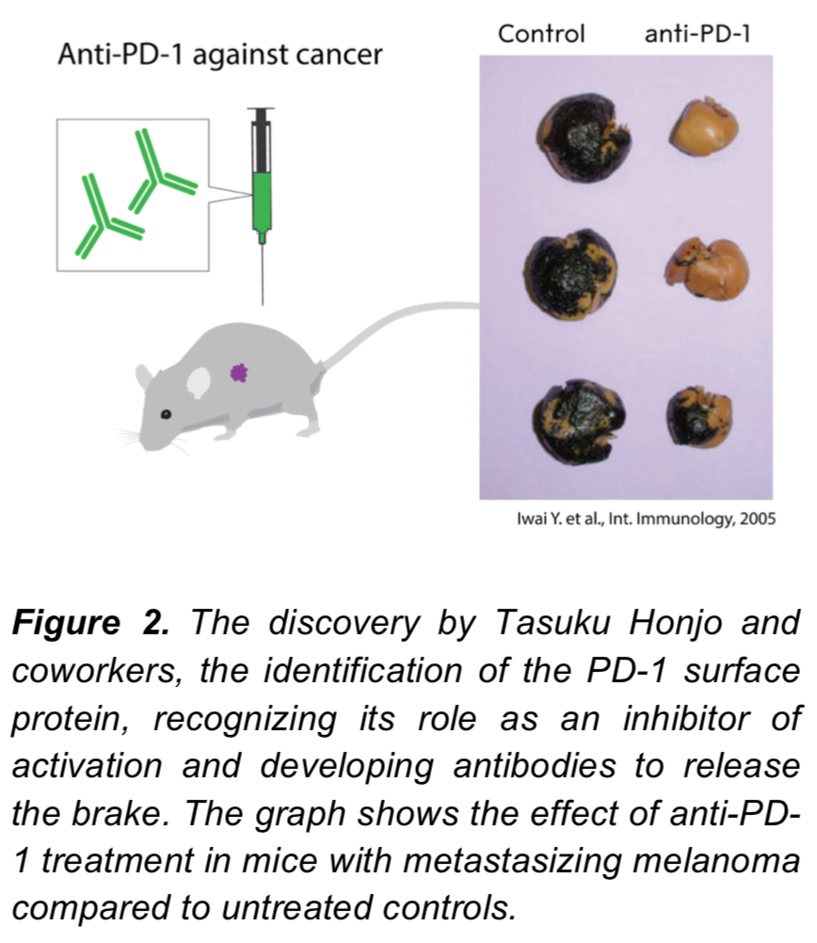
Tasuku Honjo & PD-1
A Different Brake
PD-1, Programmed cell death protein 1
Press release. NobelPrize.org. Nobel Prize Outreach 2025. Sun. 20 Jul 2025. <https://www.nobelprize.org/prizes/medicine/2018/press-release/>

Slide 39
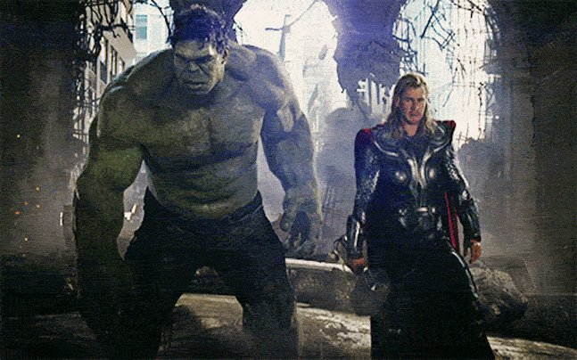
Autoimmune Side Effects
Overactive T-cells can attack healthy cells
So, carefully unleash the Hulk
"friendly fire" mishap

Slide 40
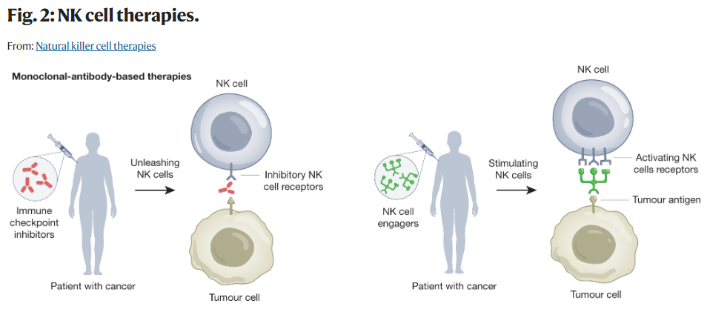


Slide 41
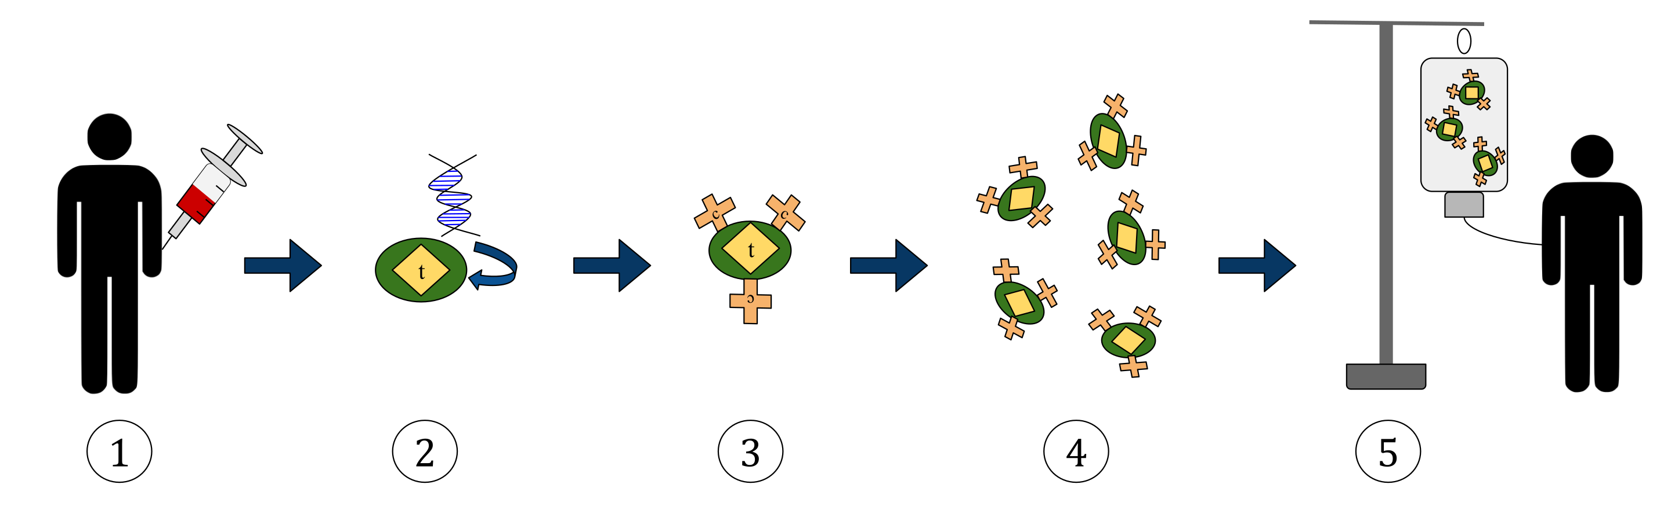
Chimeric Antigen Receptor (CAR) T-cell Therapy
https://commons.wikimedia.org/wiki/File:CAR_T-cell_Therapy.svg#/media/File:CAR_T-cell_Therapy.svg

